Slide 1
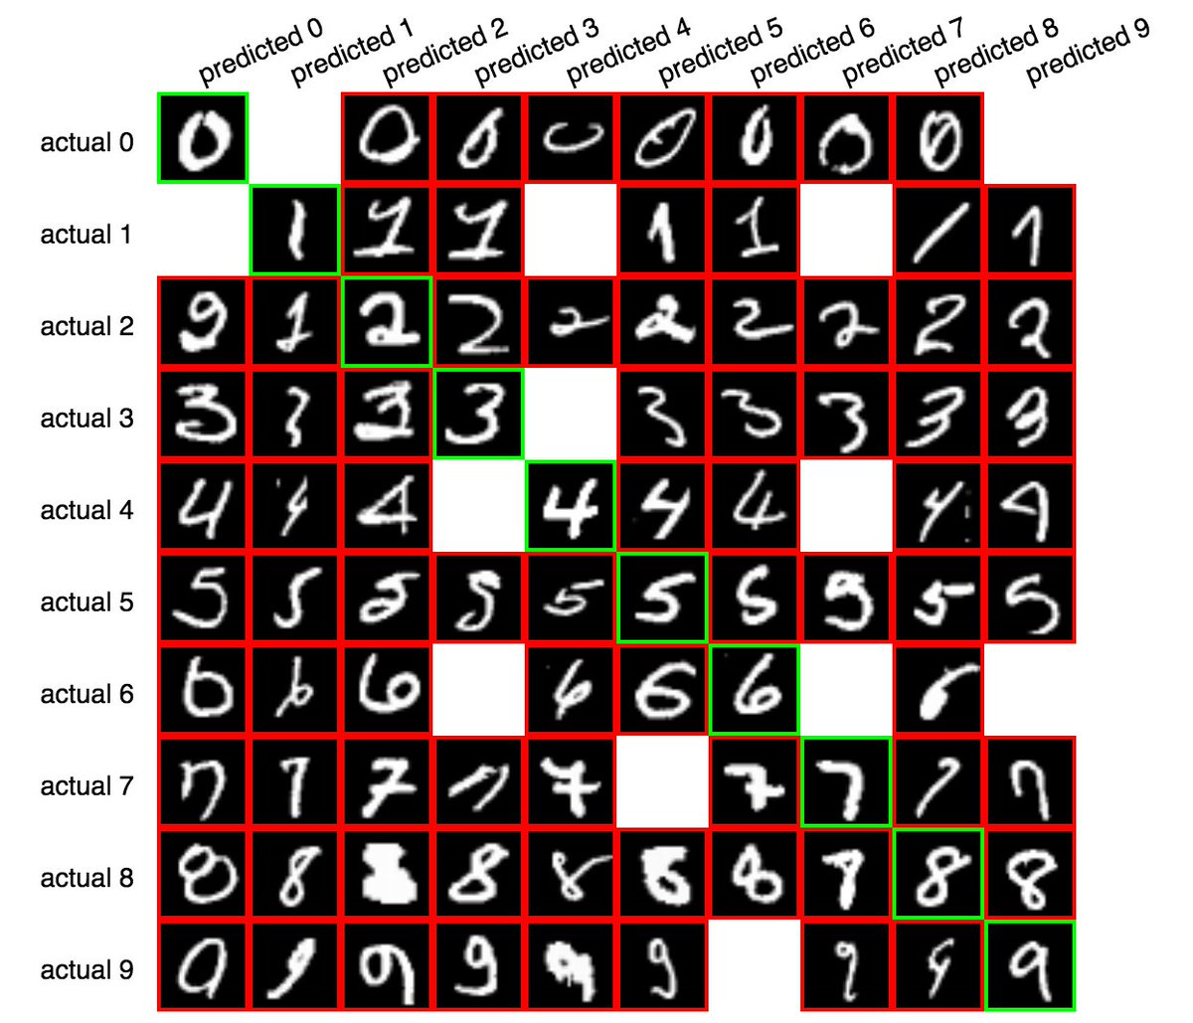
Unit V

Slide 2
Singular Value Decomposition
Principle Component Analysis

Slide 3
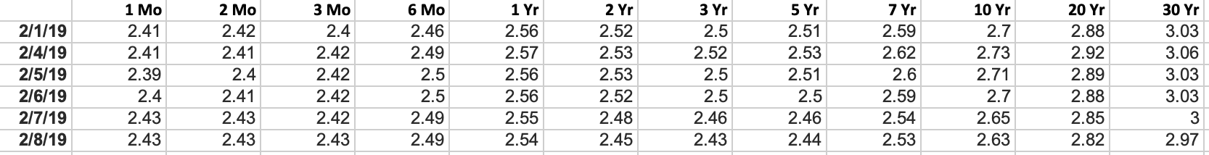
In machine learning (ML), some of the most important linear algebra concepts are the singular value decomposition (SVD) and principal component analysis (PCA).
With all the raw data collected, how can we discover structures? For example, with the interest rates of the last 6 days, can we understand its composition to spot trends?

Slide 4
This becomes even harder for high-dimensional raw data. It is like finding a needle in a haystack. SVD allows us to extract and untangle information.
In simple terms, take the number 8, you can factorize this into 2x4, or 2x2x2 right?
SVD is the same thing, It is a matrix factorization technique where a matrix is decomposed into a product of a square matrix, a diagonal (possible rectangular) matrix, and another square matrix.

Slide 5
It’s useful because this can actually reduce the size of the data you’re dealing with. (i.e., the SVD and PCA version could be less numbers overall than the original matrix) - this can reduce RAM usage
Singular Value Decomposition (SVD) and PCA is a common dimensionality reduction technique in data science

Slide 6
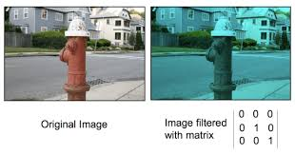
Applications
Image Compression
Image Recovery
Eigenfaces
Spectral Clustering
Background Removal from Videos

Slide 7
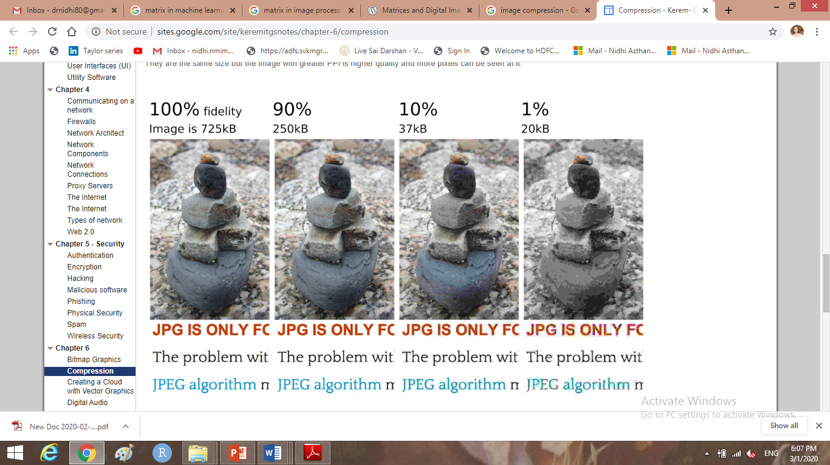
SVD for Image Compression
How many times have we faced this issue? We love clicking images with our smartphone cameras and saving random photos off the web. And then one day – no space! Image compression helps deal with that headache.
It minimizes the size of an image in bytes to an acceptable level of quality. This means that you are able to store more images in the same disk space as compared to before.

Slide 8


Slide 9
SVD for Image Recovery
Ever clicked an image in low light? Or had an old image become corrupt? We assume that we cannot get that image back anymore. It’s surely lost to the past. Well – not anymore!
We’ll understand image recovery through the concept of matrix completion
Matrix Completion is the process of filling in the missing entries in a partially observed matrix.

Slide 10


Slide 11
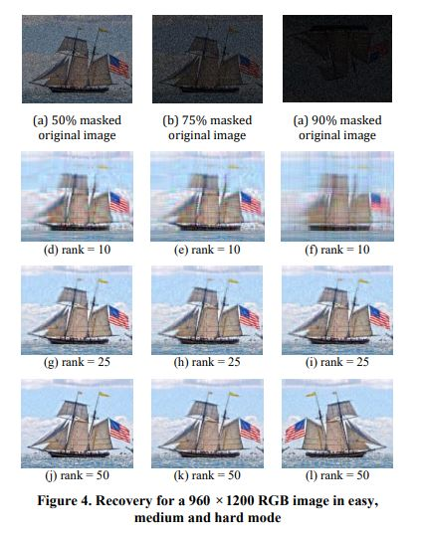

Slide 12
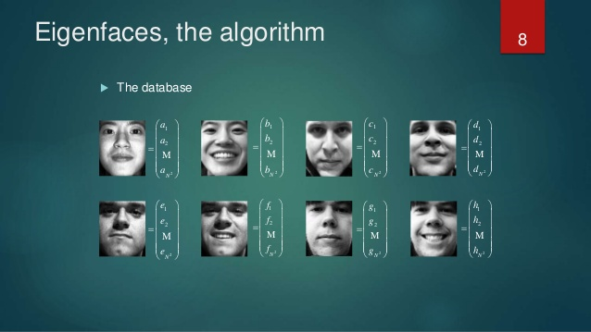
Eigenfaces
The encoding is obtained by expressing each face as a linear combination of the selected eigenfaces in the new face space. You can find these eigenfaces using both PCA and SVD.

Slide 13
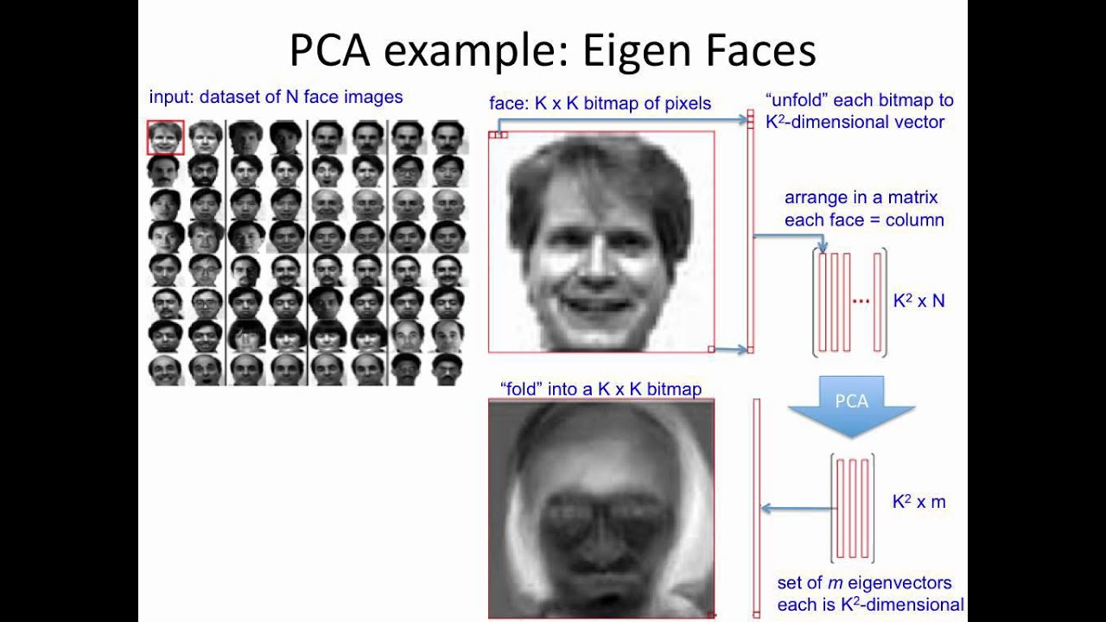

Slide 14
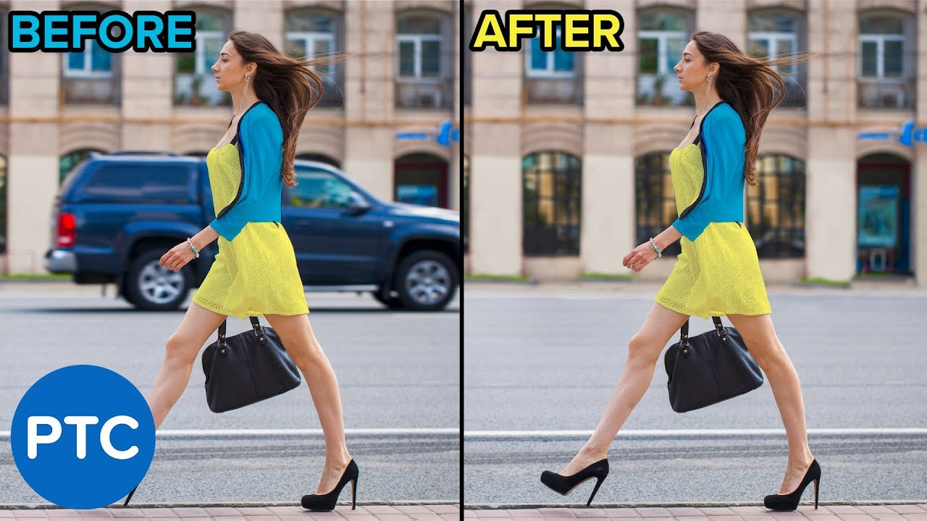
Removing Background from Videos
I have always been curious how all those TV commercials and programs manage to get a cool background behind the actors. While this can be done manually, why put in that much manual effort when you have machine learning?

Slide 15
Create matrix M from video – This is done by sampling image snapshots from the video at regular intervals, flattening these image matrices to arrays, and storing them as the columns of matrix M
We can, therefore, think of M as being the sum of two matrices – one representing the background and other the foreground
The background matrix does not see a variation in pixels and is thus redundant i.e. it does not have a lot of unique information. So, it is a low-rank matrix
So, a low-rank approximation of M is the background matrix. We use SVD in this step
We can obtain the foreground matrix by simply subtracting the background matrix from the matrix M

Slide 16
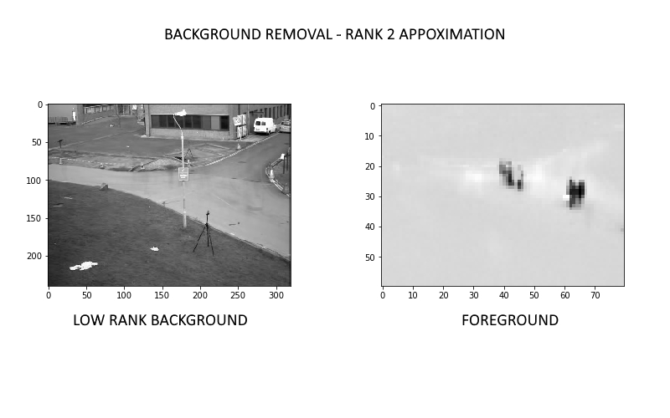

Slide 17


Slide 18
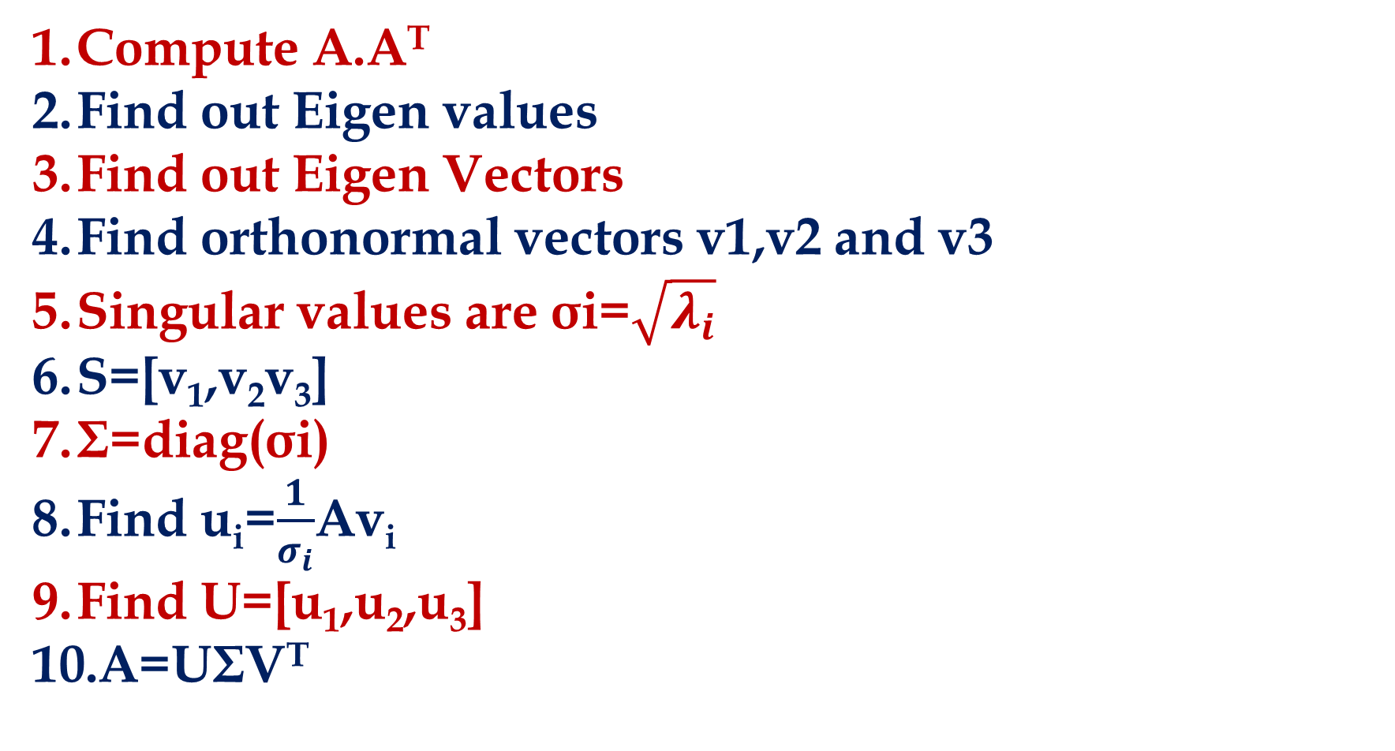
SINGULAR VALUE DECOMPOSITION (SVD)
Compute A.A^{T}
Find out Eigen values
Find out Eigen Vectors
Find orthonormal vectors v1,v2 and v3
Singular values are σi=$\sqrt{λ_{i}}$
S=[v₁,v₂v₃]
Σ=diag(σi)
Find u_{i}=$\frac{1}{σ_{i}}$Av_{i}
Find U=[u₁,u₂,u₃]
A=UΣV^{T}

Slide 19
Find the Singular Value Decomposition of Matrix:

Slide 20
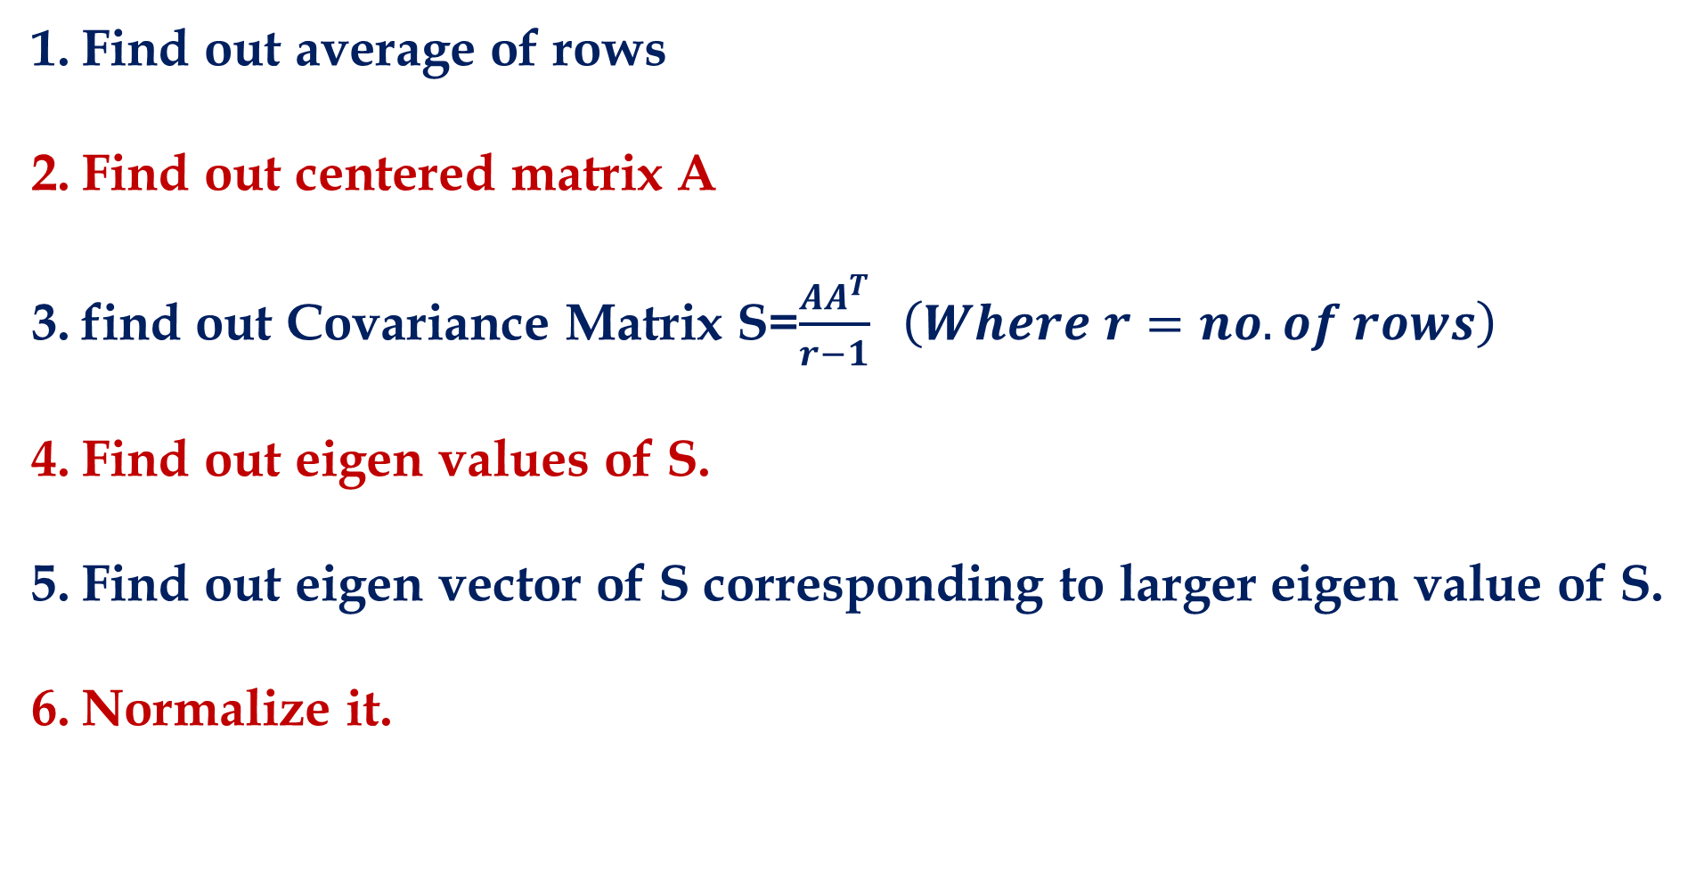
PRINCIPLE COMPONENT ANALYSIS (PCA)
Find out average of rows
Find out centered matrix A
find out Covariance Matrix S=$\frac{AA^{T}}{r−1} \left(Where r=no. of rows\right)$
Find out eigen values of S.
Find out eigen vector of S corresponding to larger eigen value of S.
Normalize it.

Slide 21
Construct the sample covariance matrix S for the data given below:
Find the eigenvector of S that points the most significant direction of the data

Slide 22
Construct the sample covariance matrix S for the data given below:
Find the eigenvector of S that points the most significant direction of the data

Slide 23
Construct the sample covariance matrix S for the data given below:
Find the eigenvector of S that points the most significant direction of the data

Slide 24


